Slide 1
Main Project
Submission Date: 10/03/2023

Slide 2
Welcome to the Presentation
Name: Suraj Patel
Enrollment No: 2204030100953
Branch: BCA
Division M1A3 (C)
Guided By: Prof. Meghana Panara

Slide 3
1. OVERview
Hello friends, This page shows the overview of my Website.
This Website is of Blog Post which mainly consist of Blogs related to nature and travel Destinations among the world.
In this website we can see the blogs of famous travel destinations and famous wildlife sanctuary.

Slide 4
2. Which languages used in this website.
1.HTML
2. CSS
3. Bootsrap
4. JavaScript

Slide 5
3.Advantages of Using this website
We can get the knowledge of the places and things happening around the world by visiting the website.
Also we can see the photos of the places or things which will be posted by the authors.
People can visit our website anytime from anyplace

Slide 6
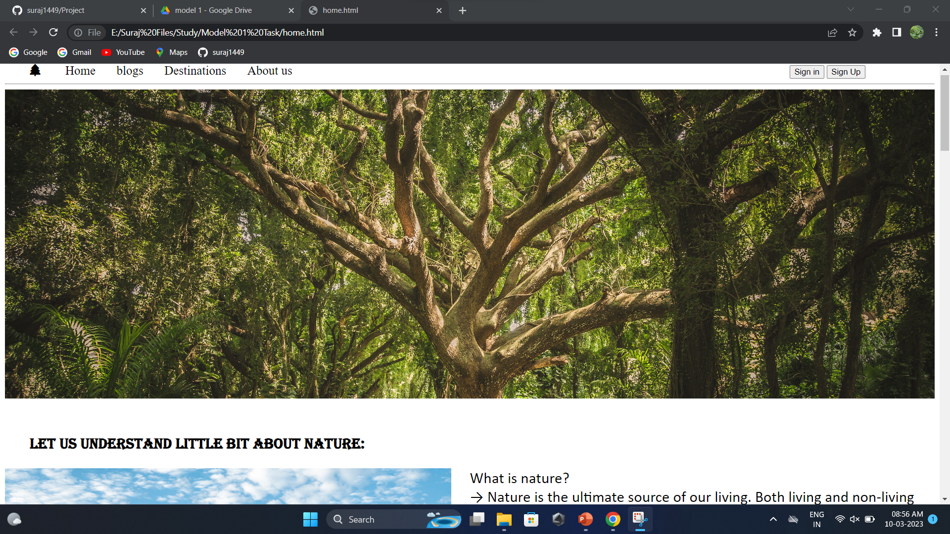
Screenshot of the website:

Slide 7
Thanking you all
Thank you all for giving your important time.
Your Faithfully,
Suraj Patel

